Slide 1
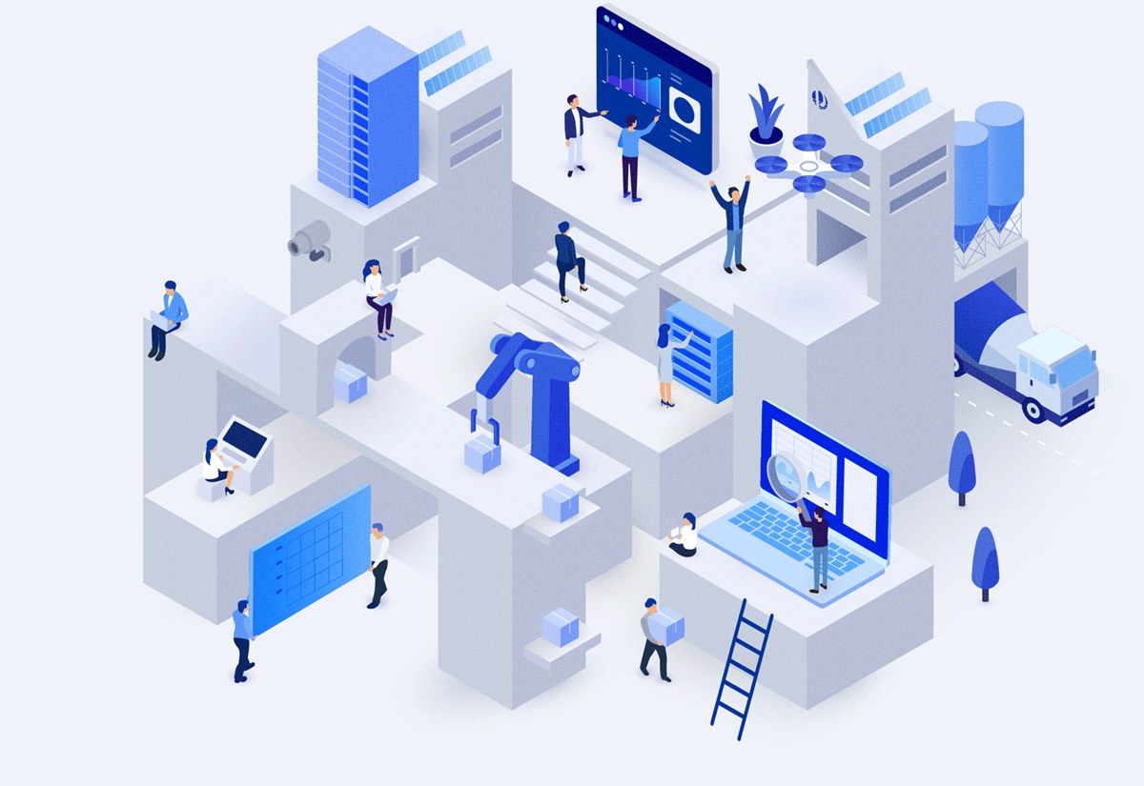
Group: 1
Class: 65.CNTT-4
Lecturer: Ha Thi Thanh Nga
CLOUD COMPUTING
The important role for students in the digital age

Slide 2

CLOUD COMPUTING - The important role for students in the digital age
01
Introduction

Slide 3
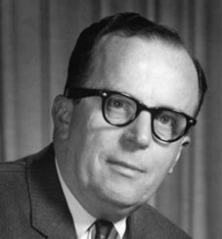

The birth of Cloud Computing
The concept originated in the 1960s by Dr. J.C.R. Licklider – who is considered the "father of cloud computing." He proposed the idea of a global computer network, called the "Intergalactic Computer Network."
However, it wasn't until the early 2000s that modern cloud infrastructure for businesses emerged. This technology has developed steadily and proven itself as one of the most important technological revolutions of the 21st century.

Slide 4



The origin and development Cloud Computing
Early 1990s:
- Internet became more accessible thanks to Apple, Microsoft, and IBM’s early innovations.
2002:
- Amazon introduced Amazon Web Services (AWS), marking a significant step in cloud computing development.
2006:
- The term “Cloud Computing” gained widespread recognition with the launch of Amazon EC2 and Google Docs, leading the way for modern cloud services.
Late 1990s:
- Internet & tech evolved rapidly. - Salesforce.com introduced cloud-based business apps. - Cloud services like Yahoo Mail gained popularity.
2004:
- Facebook emerged, defining the concept of "cloud for individuals," bringing cloud computing closer to personal users.

Slide 5
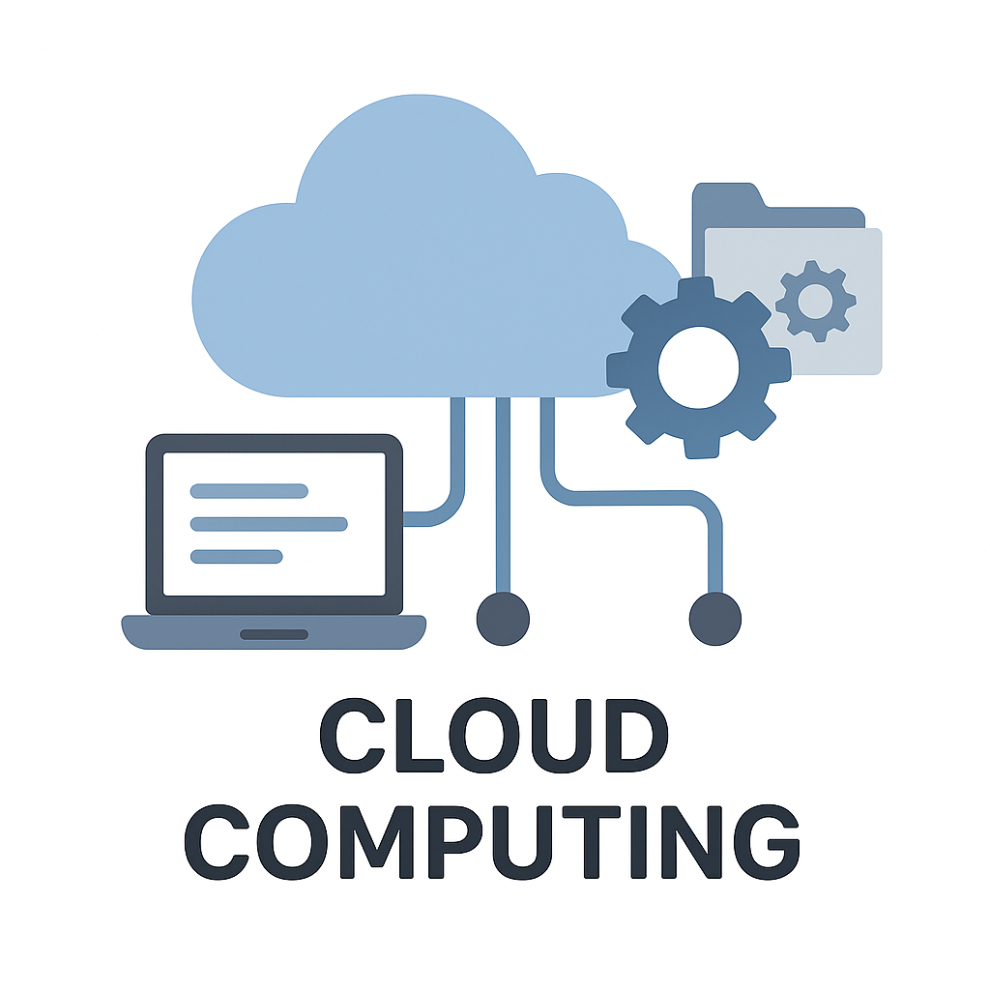
What is Cloud Computing?
Cloud computing is a model for providing on-demand access to a shared pool of computing resources over the Internet. These resources encompass a wide range of computing-related elements, such as software, services, and hardware, and are located on virtual servers (the cloud) on the network.

Slide 6
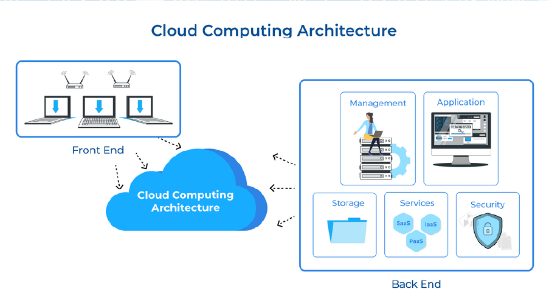
How Cloud Computing works
Cloud computing operates by allowing users to upload and download data stored on the cloud platform.
Cloud computing can be divided into two systems: the front-end and the back-end.
These two ends are connected through the support of an Internet connection.
All these features and functions are managed by a central server, which ensures everything runs smoothly and efficiently.

Slide 7




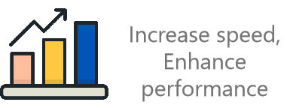
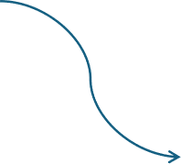




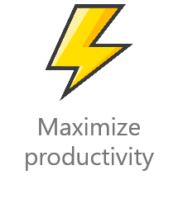
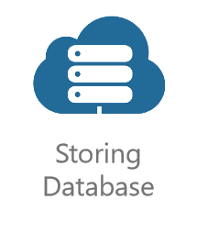

The role of Cloud Computing business and life

Slide 8
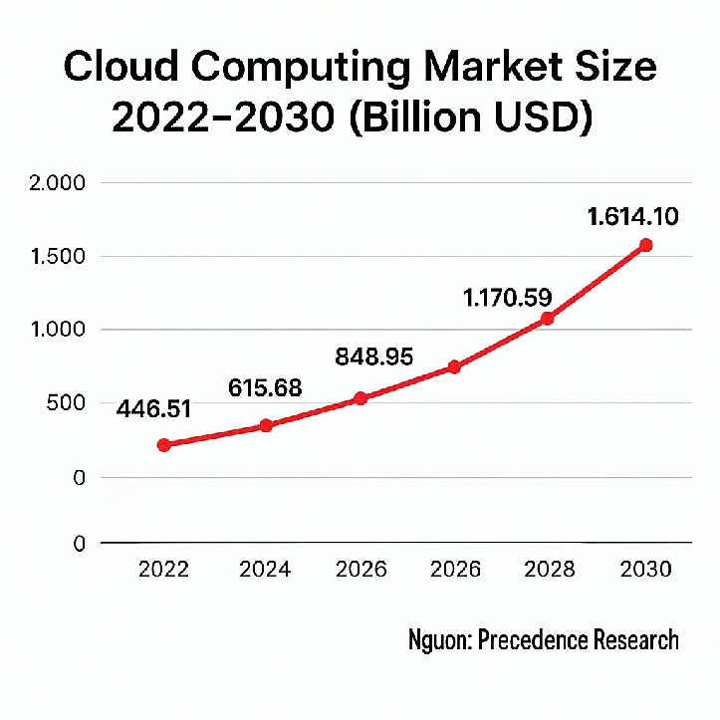

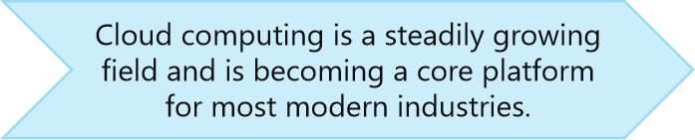
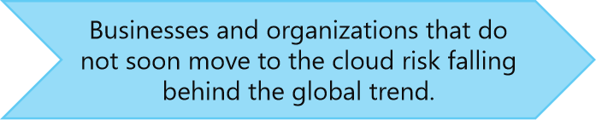
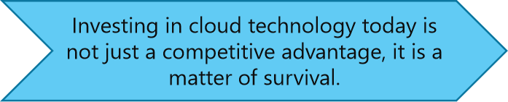
Cloud Computing market statistics

Slide 9
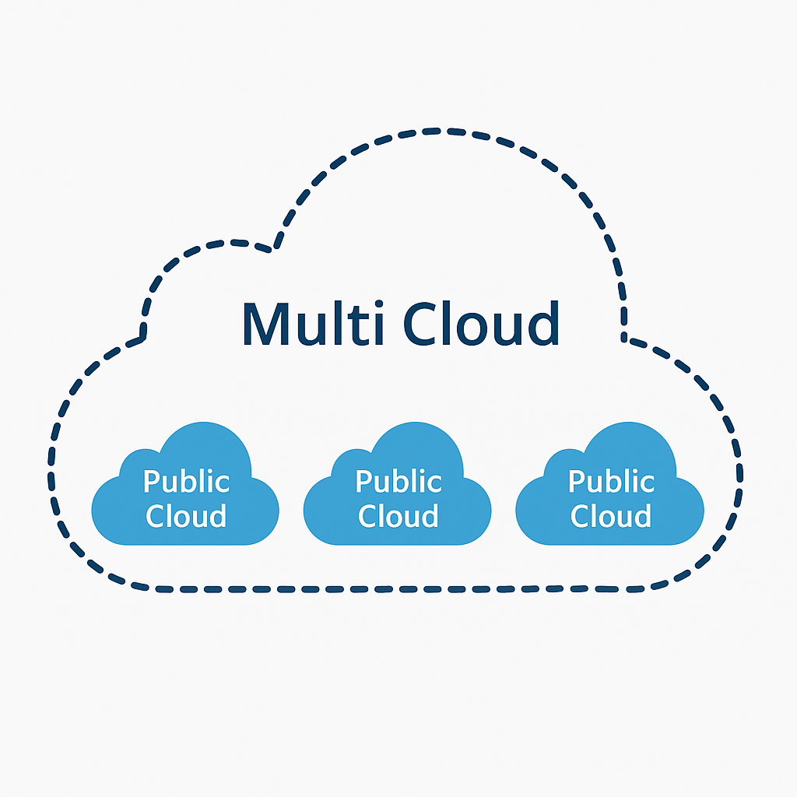
CLOUD COMPUTING - The important role for students in the digital age
02
Cloud Computing models

Slide 10
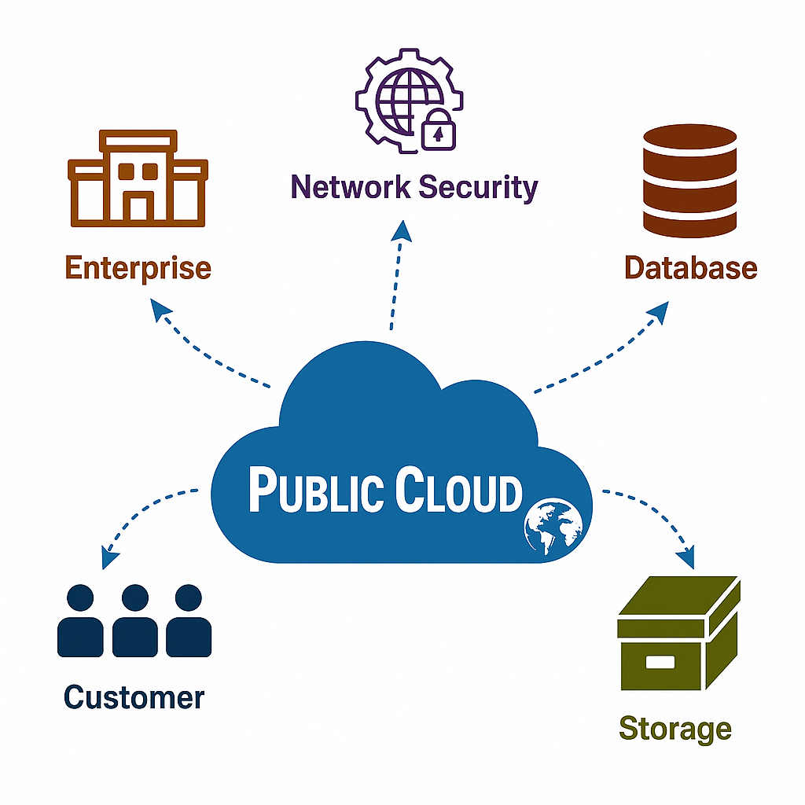
Public Cloud

Slide 11
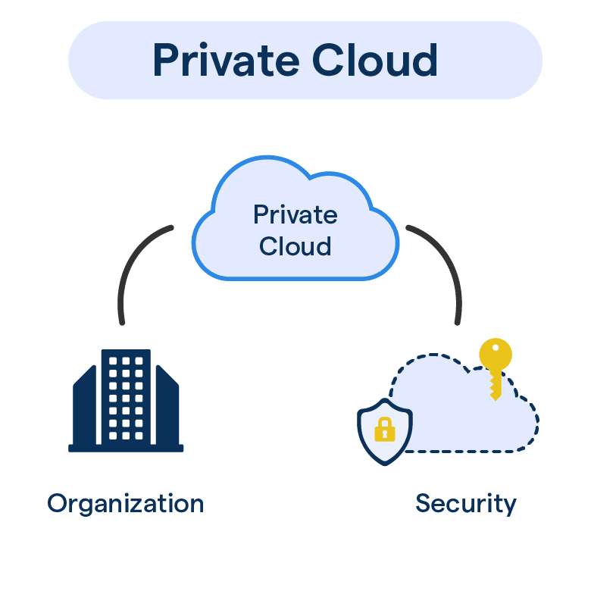
Private Cloud
Exclusive Infrastructure
Enhanced Security
Customizable Environment

Slide 12
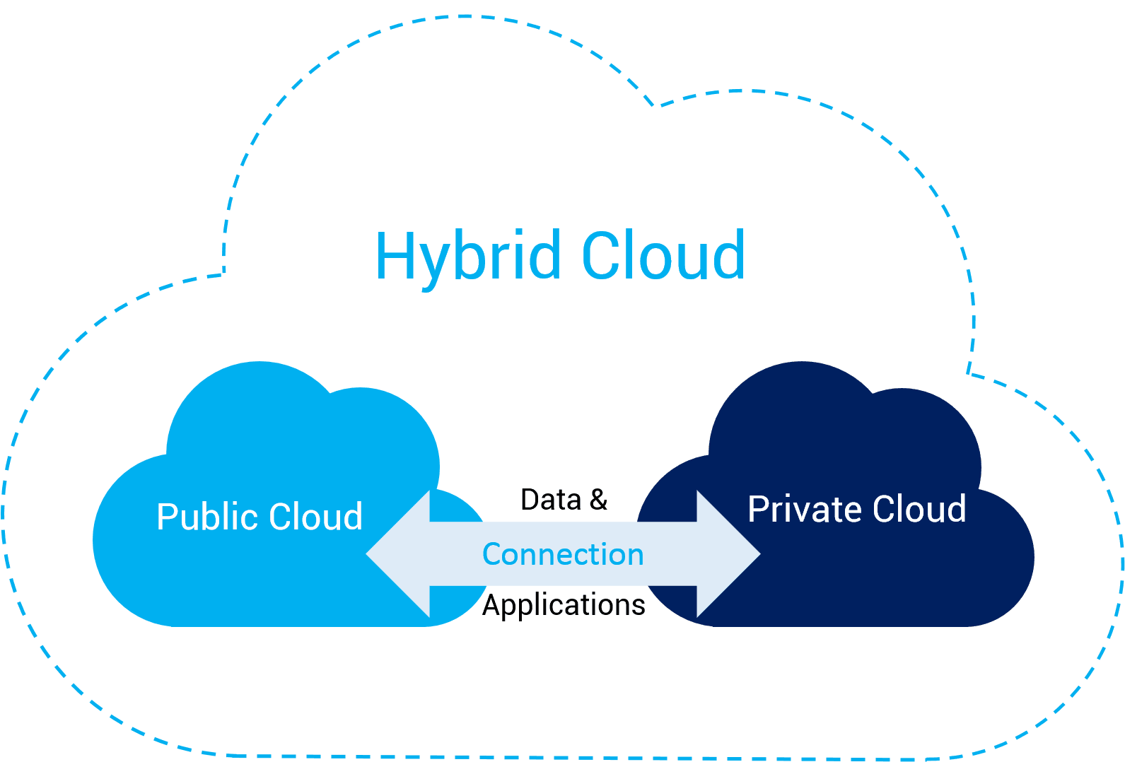
Hybrid Cloud

Slide 13
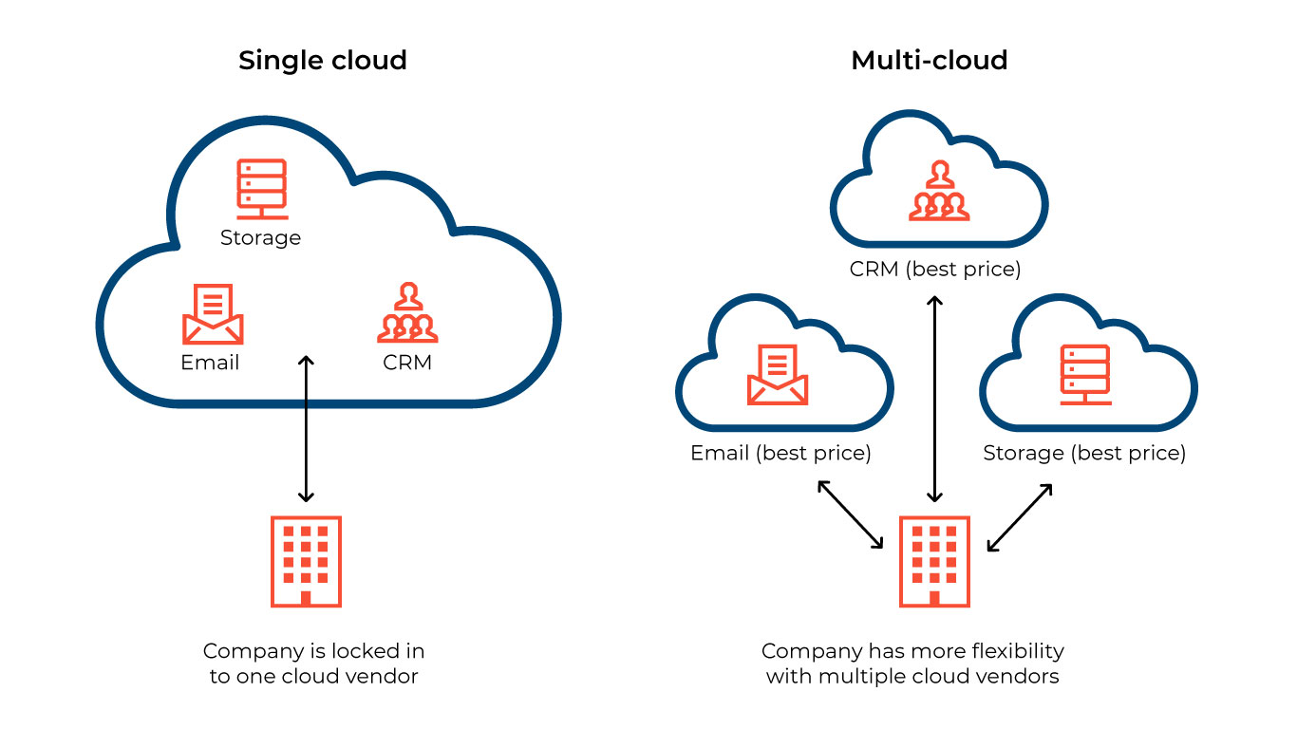
Multi-Cloud

Slide 14
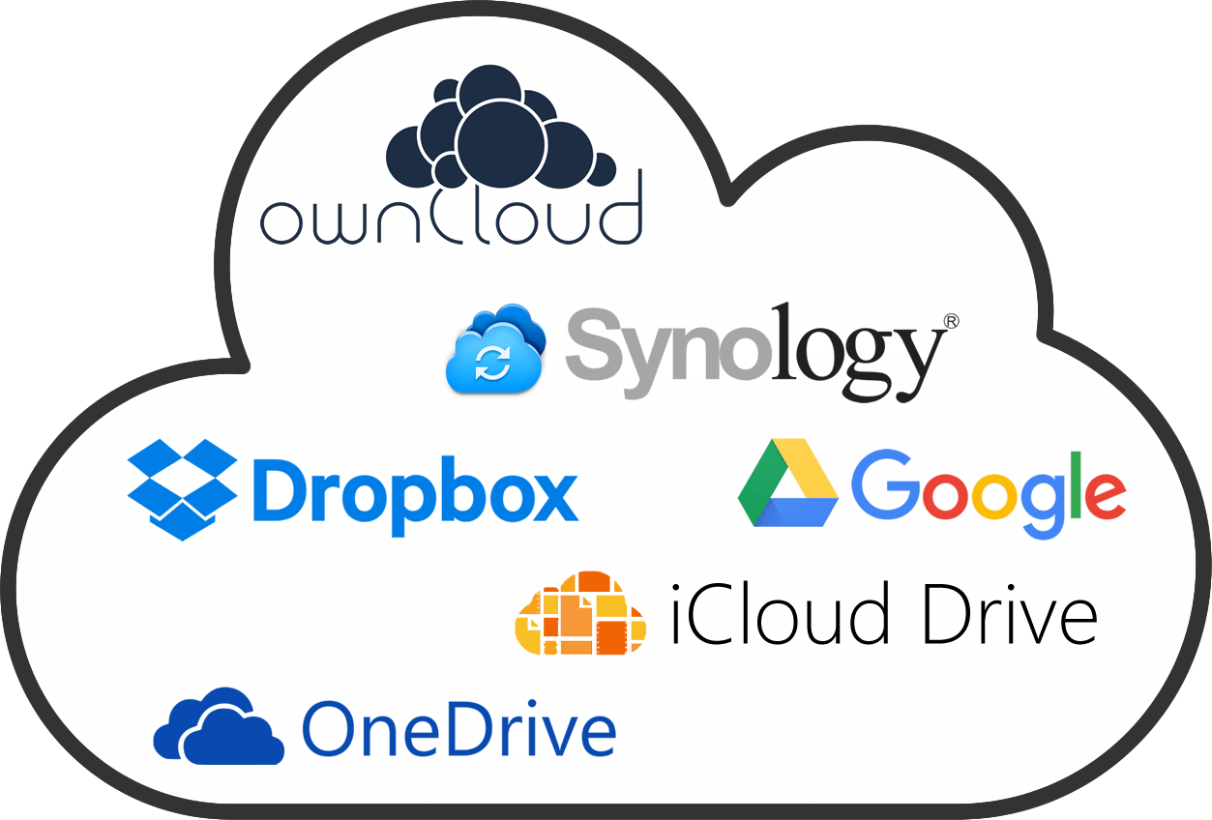
CLOUD COMPUTING - The important role for students in the digital age
03
Application of Cloud Computing

Slide 15

Cloud Computing for Students
Google Drive: Store assignments, share projects.
Google Classroom: Access lessons, collaborate online.
GitHub: Code management.
Canva: Create presentations easily.

Slide 16
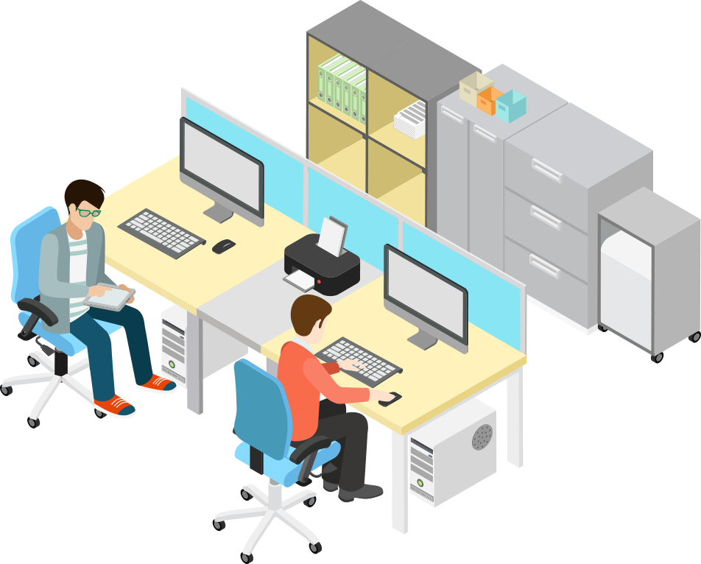
Cloud Computing for Employees
Zoom: Online meetings
Dropbox: Access files anywhere
GitLab: Manage code and automate DevOps workflows

Slide 17
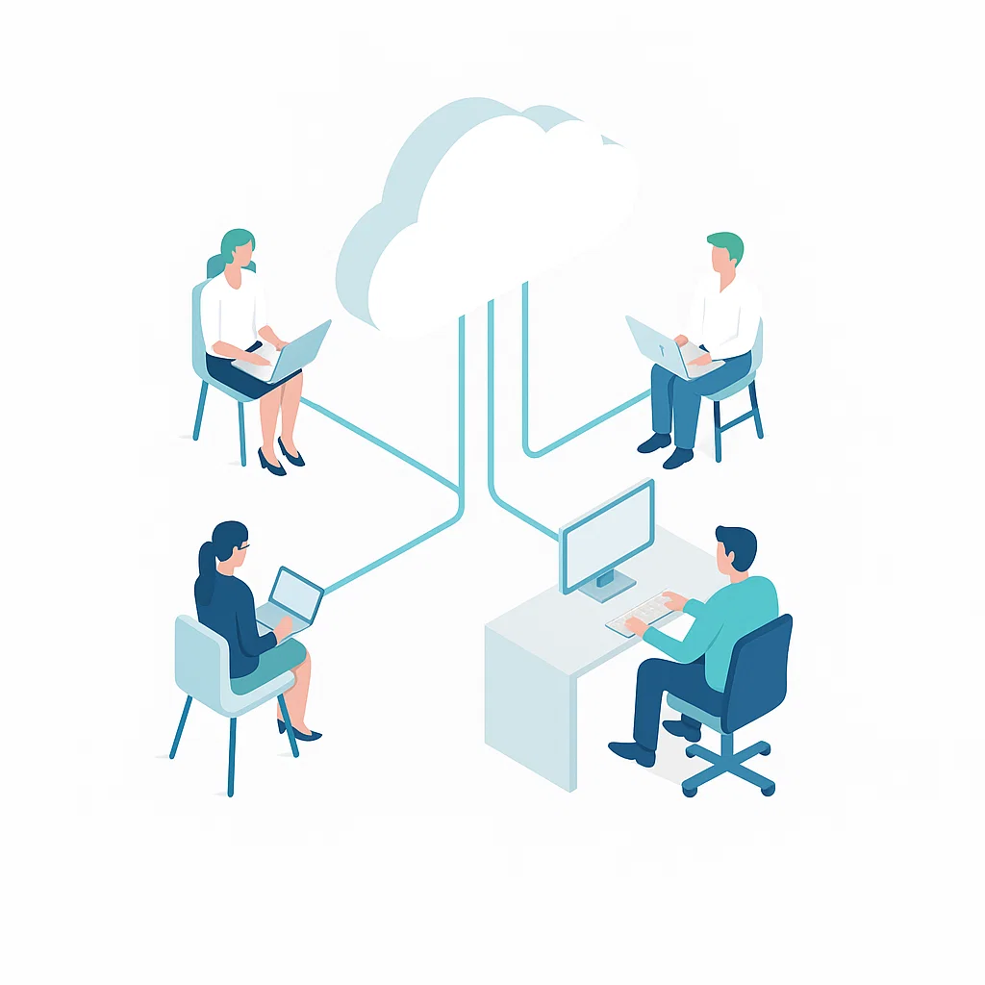
CLOUD COMPUTING - The important role for students in the digital age
04
Challenges of Cloud Computing

Slide 18

Risk and security of Cloud Computing
Potential Data Breaches
Misconfigurations can expose sensitive data.
Insider Threats
Employees or contractors may exploit access.
Shared Responsibility
Users and providers both must secure systems.

Slide 19
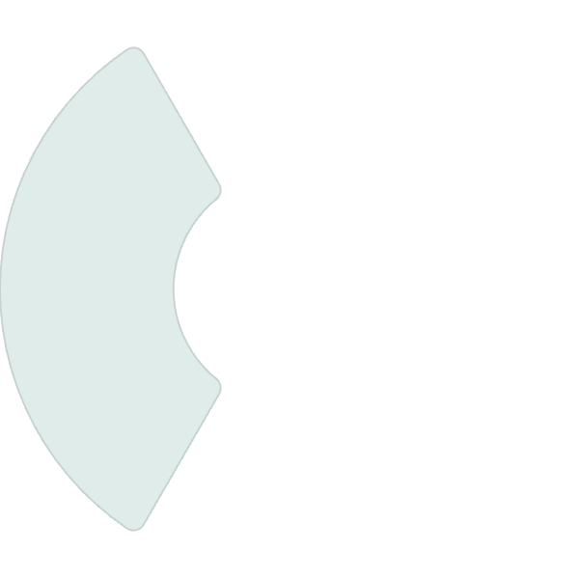


Dependence on service providers
Data Ownership
Contract terms can affect control over data.
2
Service Reliability
Outages can disrupt
business operations.
1
3
Vendor Lock-in
Switching providers can be complex and costly.

Slide 20
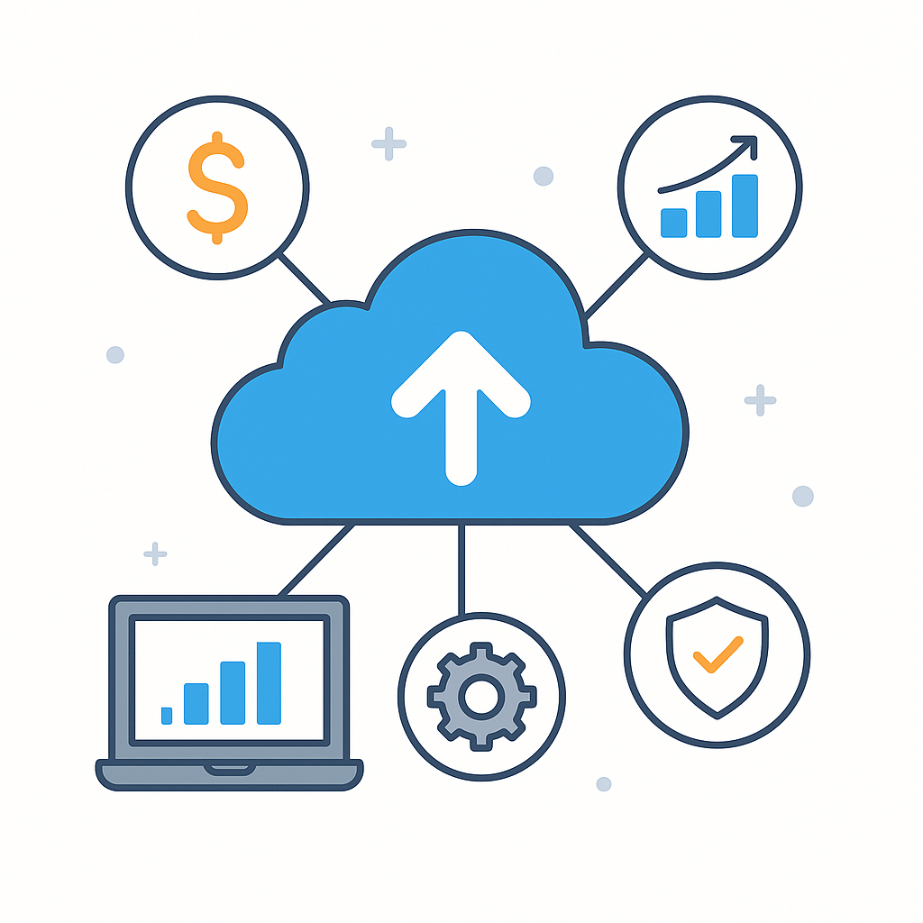
CLOUD COMPUTING - The important role for students in the digital age
05
Benefits of Cloud Computing

Slide 21
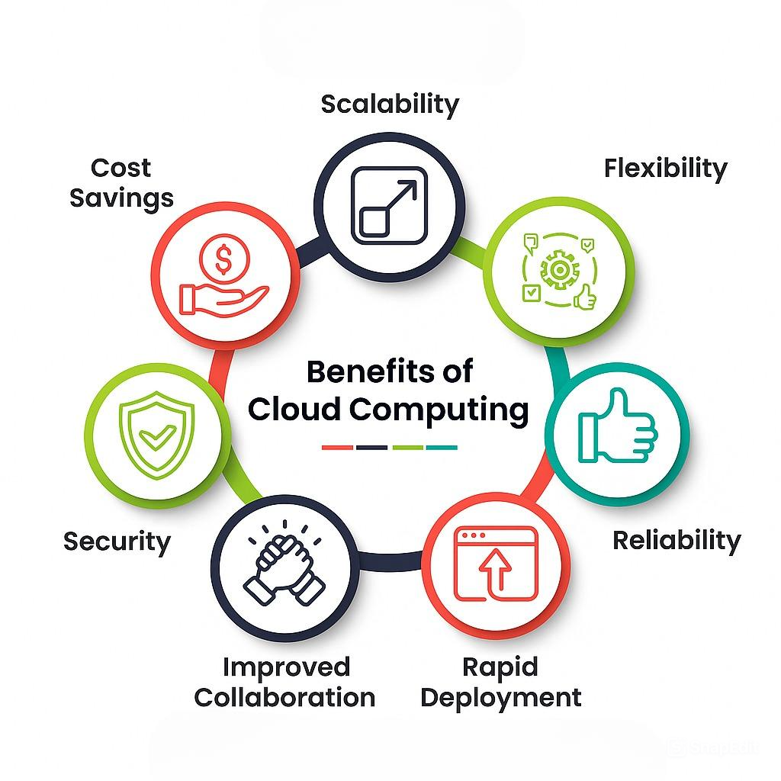
Dependence on service providers
Cloud can scale resources up or down depending on usage needs.
Pay only for what you use many services are free for students.
You can access resources from anywhere, on any device with an Internet connection.
Major cloud providers like AWS, Azure, and Google Cloud implement advanced security measures such as data encryption, multi-factor authentication, and intrusion detection to protect user data.
Cloud services often have backup systems, data distribution and incident recovery plans, which keep the system running.
Team members can share files and collaborate on the same document or project at the same time, no matter where we are.
You can deploy software, applications, or servers within minutes instead of hours or days using traditional methods. This saves time and helps us deploy services faster.

Slide 22

CLOUD COMPUTING - The important role for students in the digital age
06
Future of
Cloud Computing

Slide 23
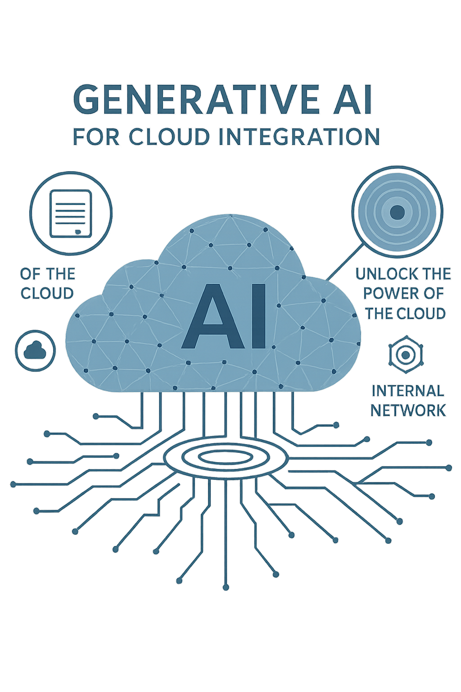
Key Future Trends
AI & Machine Learning Integration
IT professionals will work closely with cloud-based AI tools for automating tasks, data analysis, and creating intelligent applications. This will reduce development time and improve software functionality.

Slide 24
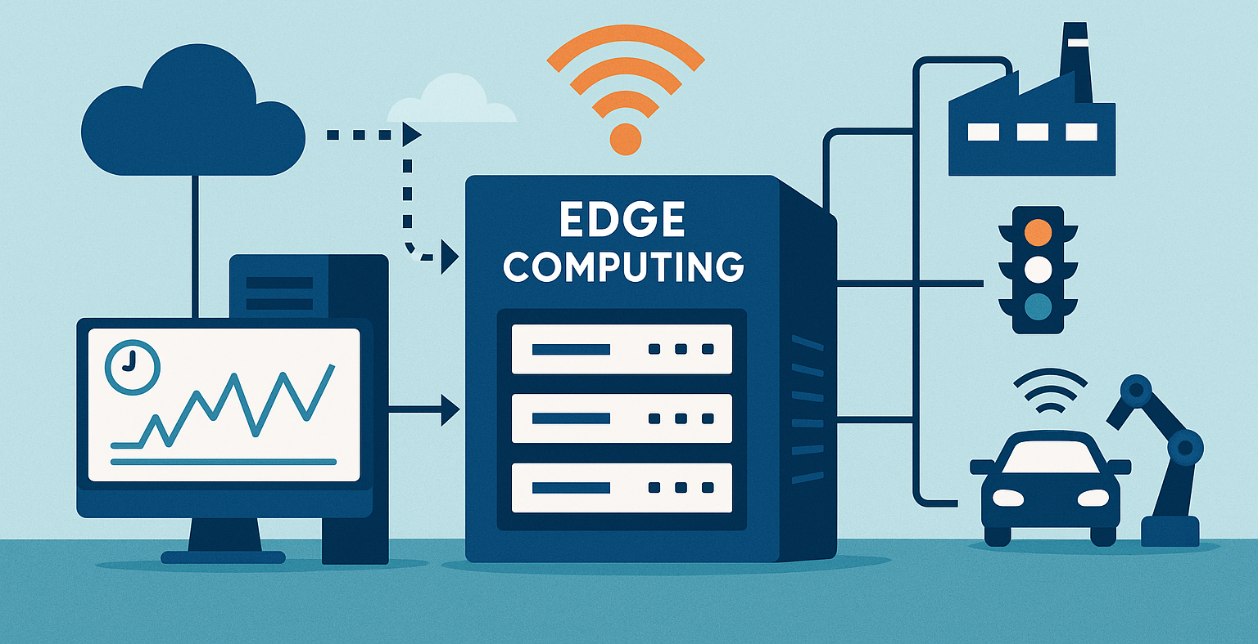
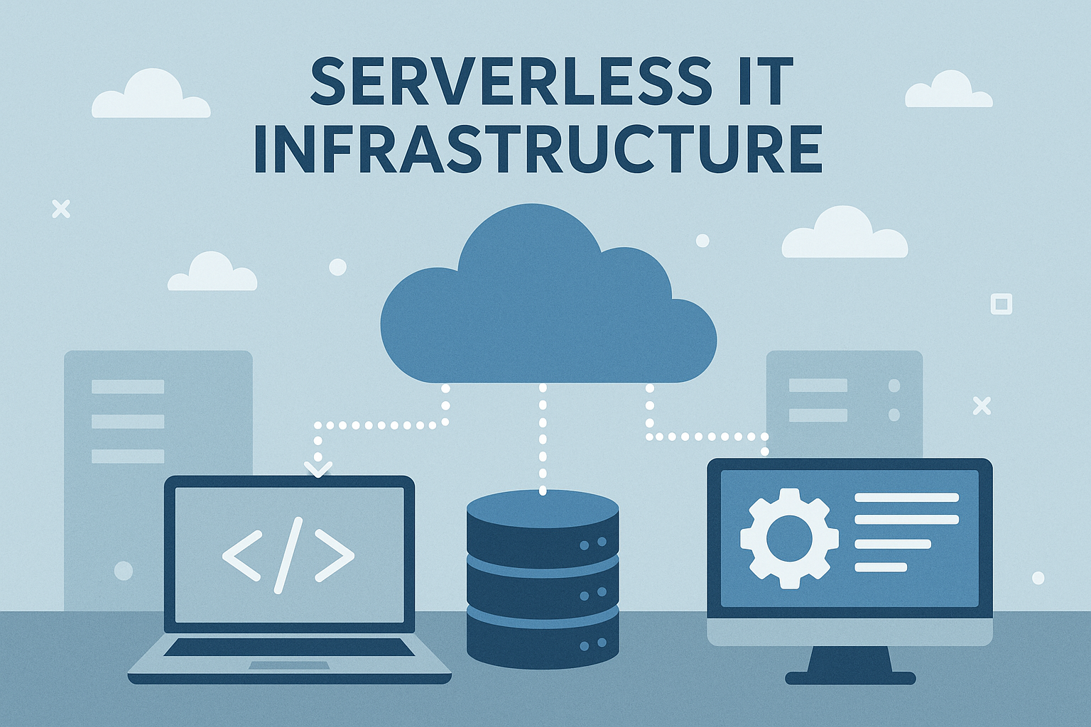
Key Future Trends
Edge Computing for Real-Time IT Systems
In IT areas like IoT, automation, and robots, edge computing will let data be processed faster. This helps make quick decisions and depends less on big data centers.
Serverless IT Infrastructure
IT developers will use serverless systems where the cloud provider manages everything. This makes it faster and cheaper to build and run programs.

Slide 25
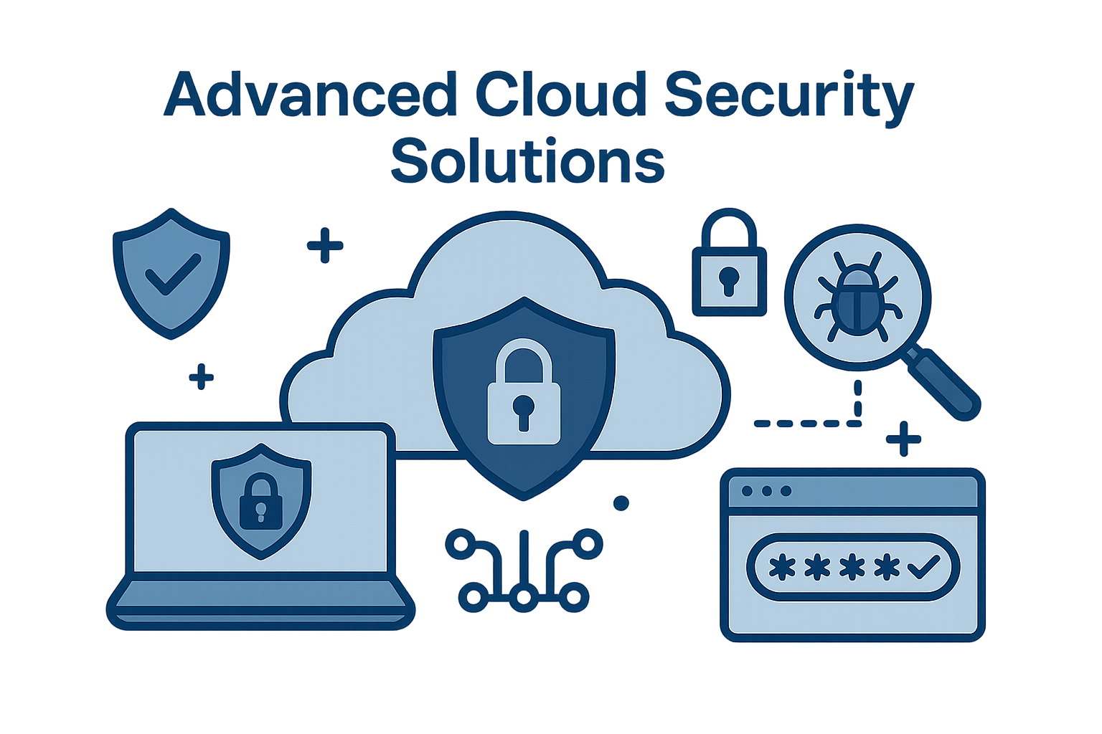
Key Future Trends
Advanced Cloud Security Solutions
With growing cybersecurity threats, IT specialists will focus more on designing secure cloud systems, implementing encryption, access control, and security rules.

Slide 26
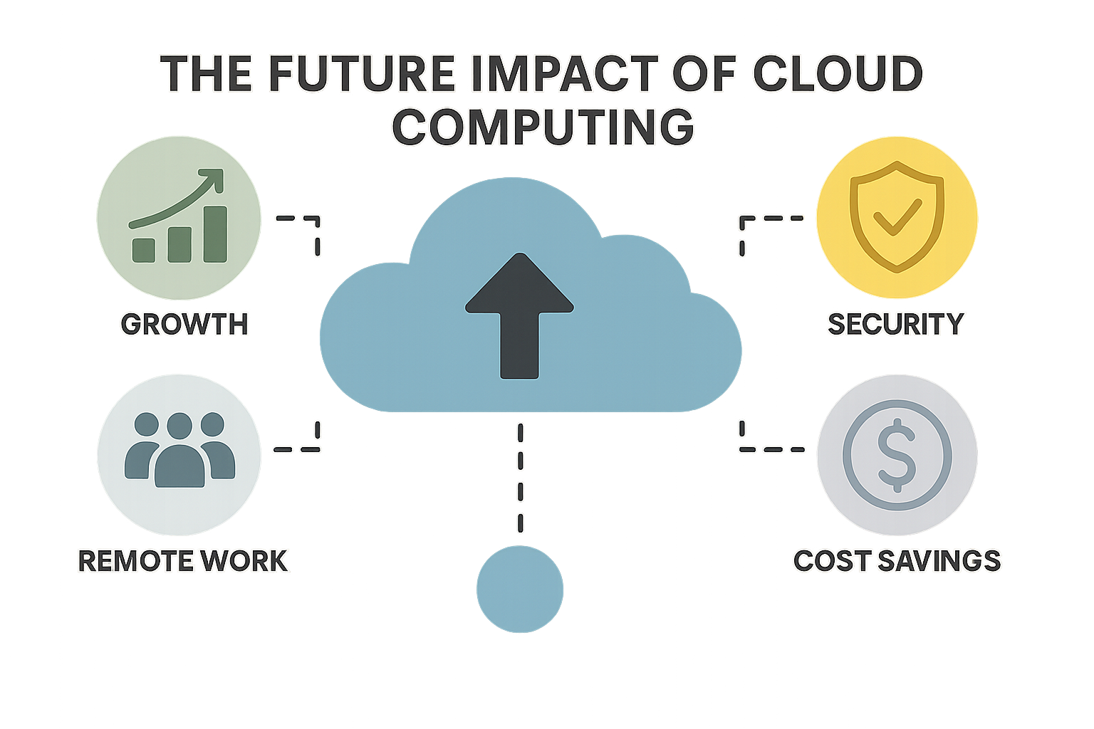
CLOUD COMPUTING - The important role for students in the digital age
07
The Future Impact of
Cloud Computing

Slide 27

Future Impact of Cloud Computing on IT Careers
Cloud Skills Will Be a Core Requirement
In the future, strong cloud knowledge will be essential for most IT jobs, and cloud skills will be considered a basic requirement instead of a special skill.

Slide 28
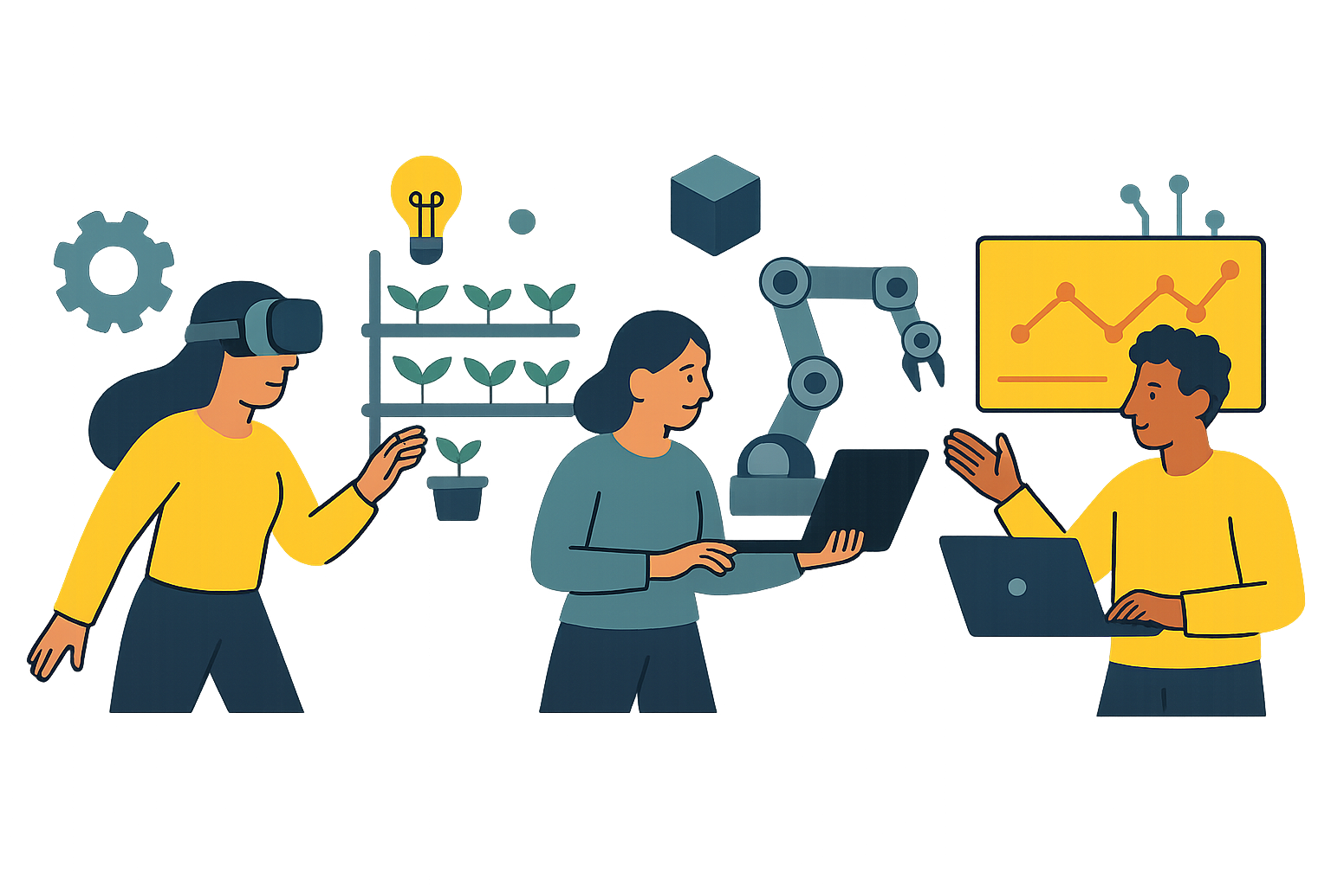
Future Impact of Cloud Computing on IT Careers
New Career Paths Will Emerge
Jobs like Cloud Security Analyst, Serverless Developer, and AI-Cloud Integration Specialist will become popular, giving IT workers more job choices.

Slide 29
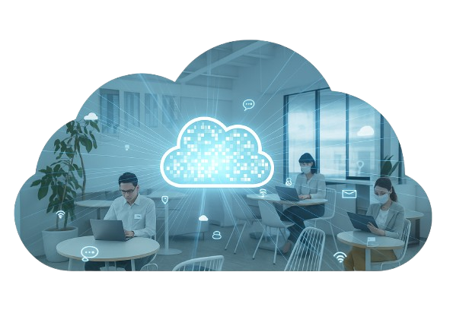
Future Impact of Cloud Computing on IT Careers
Greater Flexibility and Global Opportunities
Cloud Computing will allow IT workers to work from anywhere, work with people from other countries, and find better-paid jobs no matter where they live.

Slide 30
Thank you!
Do you have any question?

